Slide 2
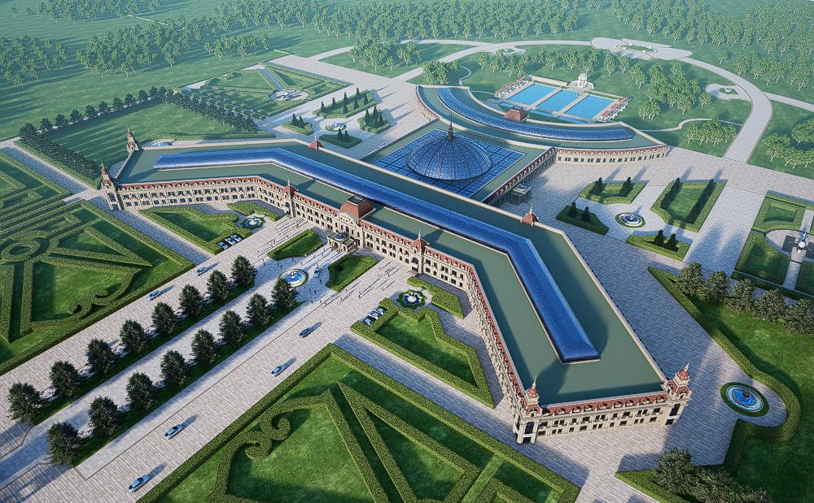
Divine Eagle Development Group & Greenlife Retirement Hotel
Ultra Luxury Living Project
Mohawk Territory of Kahnawake

Slide 3
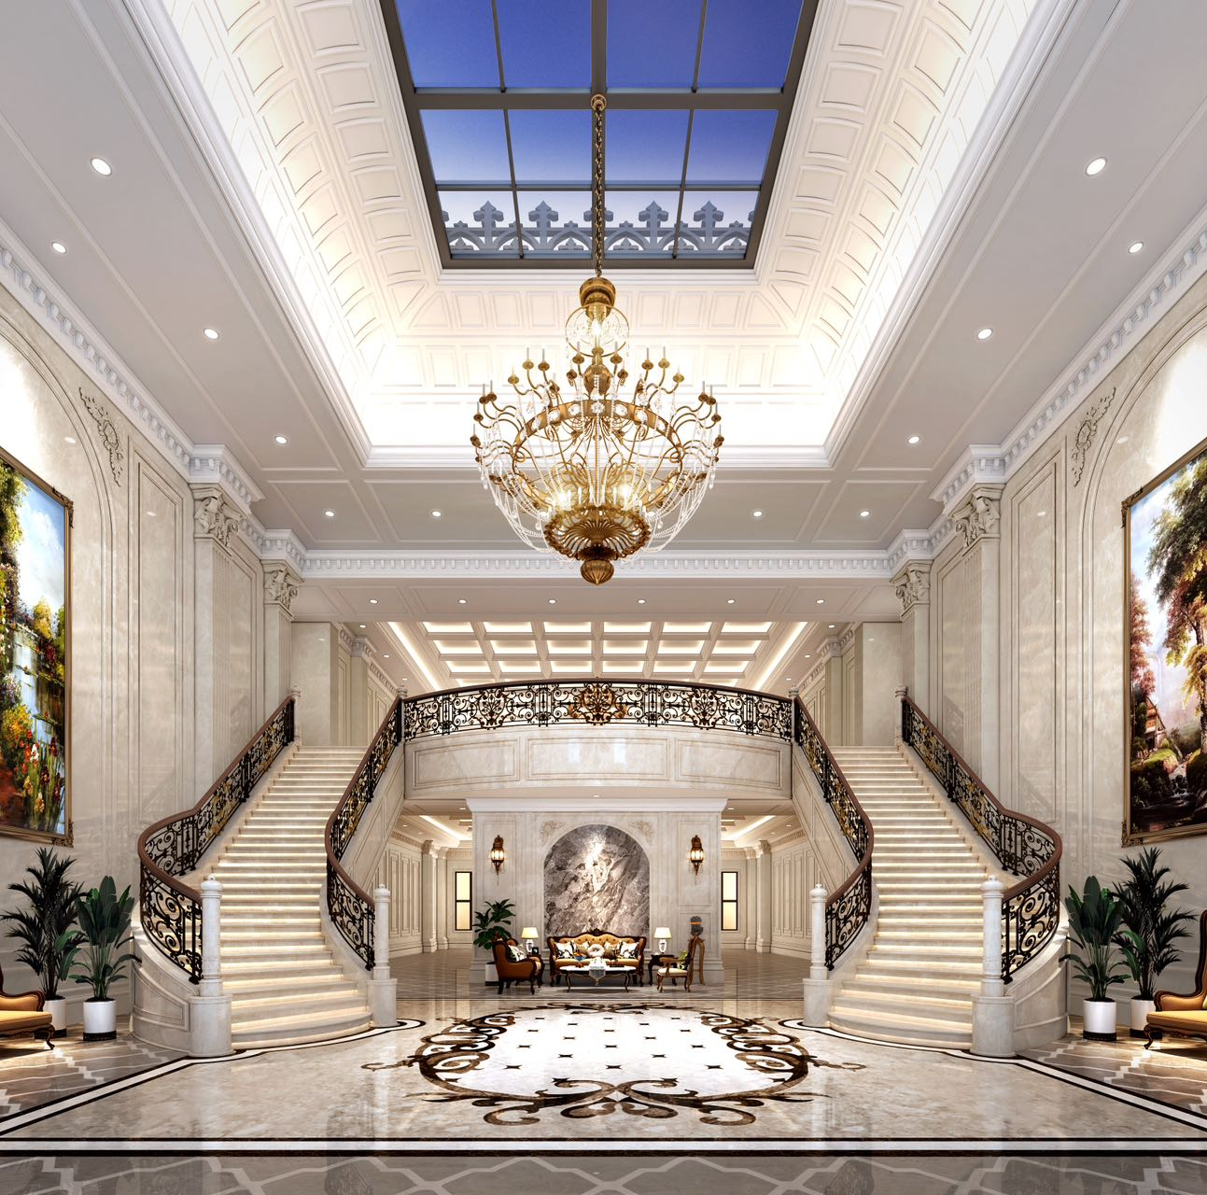
Summer in North, Winter in South.
Greenlife VIP Retirement is a five-star living experience.
Spend your summers in gorgeous Kahnawake Mohawk Territory.
Travel via private jet to Winter in our facility in Freeport Grand Bahamas.
This high security locations will feature opulence and luxury in units ranging from 2,000 square feet to 5,000 square feet. Residents will enjoy 24/7 services from, personal nurses, doctor on location, personal chefs, personal support workers, personal housekeepers and 24/7 dining.
Supervised activities will include fitness classes, art classes, yoga, guest entertainers and speakers, aqua therapy and workshops.
Amenities will include 24/7 concierge, multiple restaurants, swimming pool with lifeguard, movie theatre, hair dressing salon, sauna, private and group gym.

Slide 4
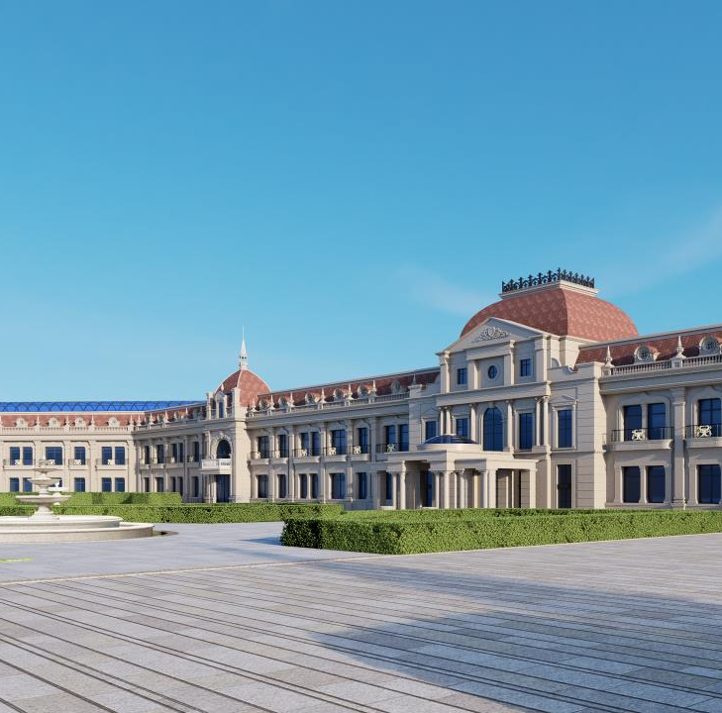
Company Overview
Divine Eagle Development Group and Greenlife Retirement have joined forces to create an ultra luxury lifestyle for seniors.
Greenlife Retirement Hotel is a full services chain of assisted-living retirement residences. Locations are licensed by the RHRA and accredited by ORCA.
Services range from exquisite Luxury Living VIP for the discerning retiree to mid range for the baby boomer generation and outreach for first nations communities.
State of the art Medical Center on site in Canada with top tier doctors and scientists on site.

Slide 5
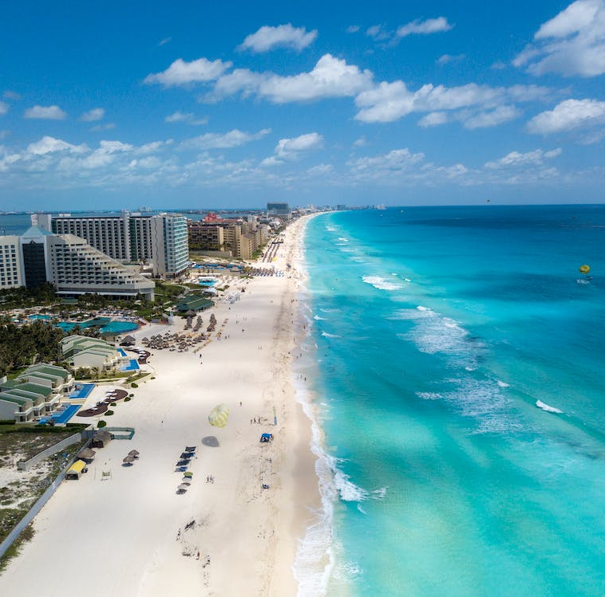
Services
Fresh new facilities designed, staffed, and equipped for optimum care.
Multicultural care delivery catering to different languages, cultures and food
Air handling systems engineered to reduce airborne pathogens.
Fully staffed with nurses, PSWs, PCWs, housekeepers, cooks, on-location maintenance.
Physician on location.
Care services range from light care to end of life.
Stable, qualified/experienced Director of care, core staff and security team
Qualified/experienced owner/operator.
Courtesy local transportation and a company private jet.
Pharmacy managed in house.
Real time monitored quality control

Slide 6
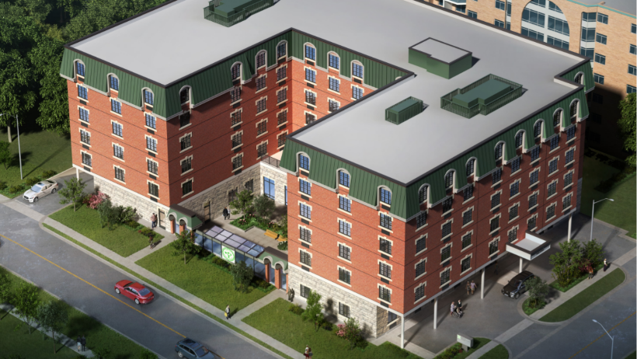
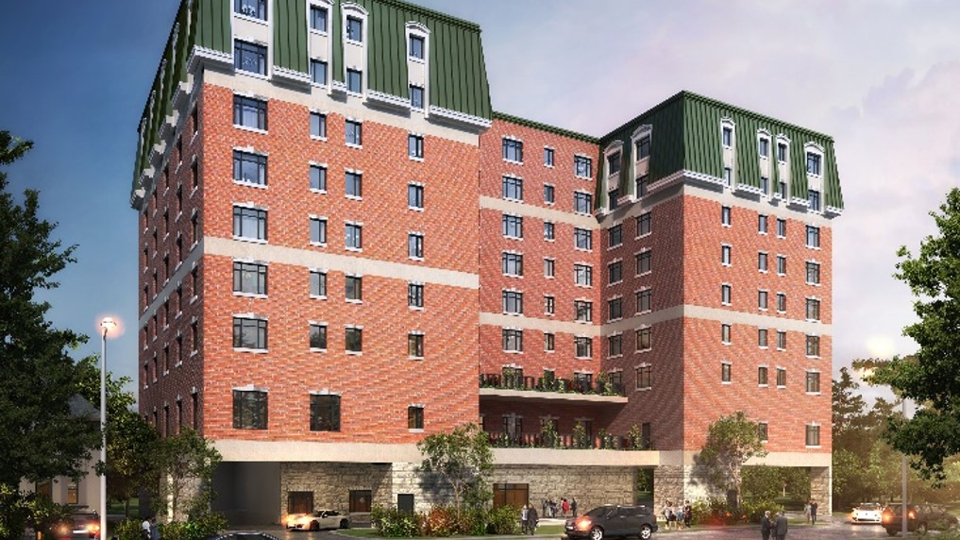
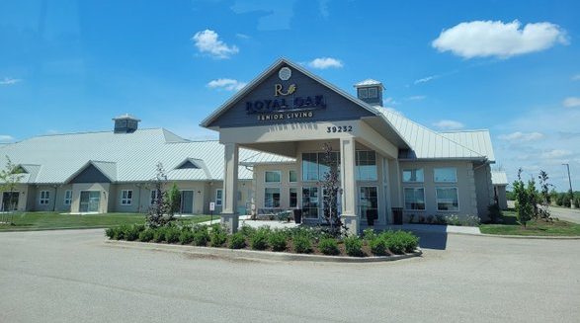
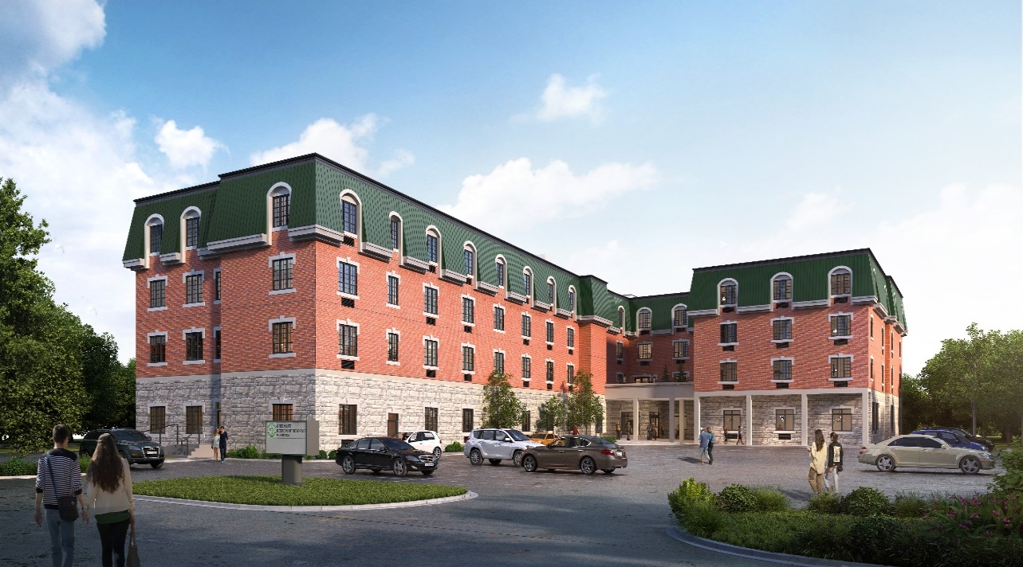
Whitby
Oshawa
St. Thomas
Trenton
Greenlife VIP

Slide 7
Greenlife Retirement Residence
info@greenliferetirement.ca
www.greenliferetirement.ca

